Slide 1
Linear Regression

Slide 2
What is OLS?
Finds best fit if
Errors have normal distribution
E(error) = 0
Greater than 20 samples
y_{i} = β₀ + β₁x_{i} + ε_{i}

Slide 3
Testing errors for normality
Normal (y – μ)²
Skew (y – μ)³
Kurtosis (y – μ)⁴

Slide 4
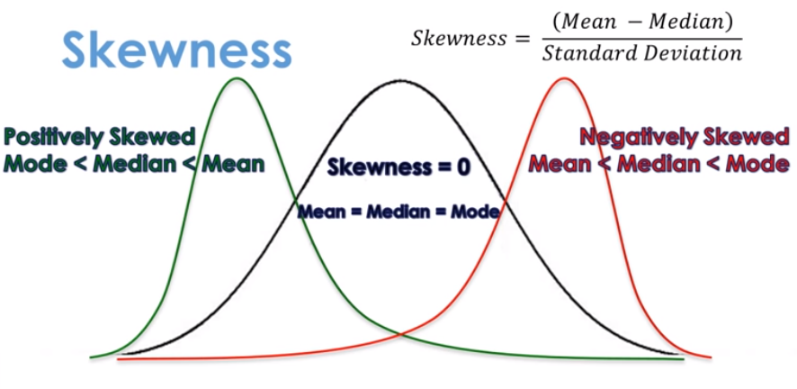

Slide 5
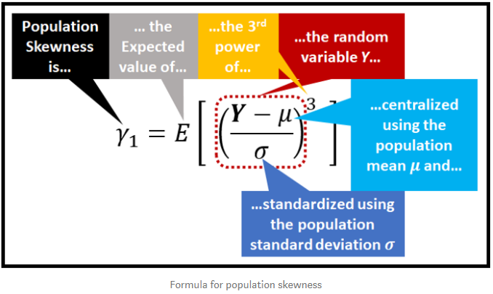
Skewness is defined as the third standardized central moment, of the random variable of the probability distribution.

Slide 6

Skewness
Standardised (i.e. mean = 0, std = 1)
Can be positive OR negative
Perfect is zero
Skewness of Normal Distribution = 0
Having Skewness = 0 DOES NOT mean distribution is symmetric
Other types of skewness: mean, medium, quartiles, etc.
Quick way to calculate:

Slide 7
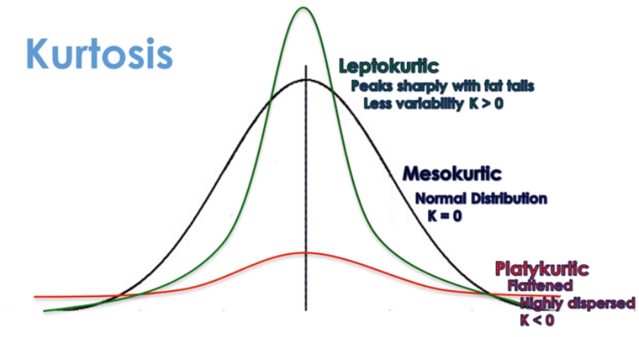

Slide 8
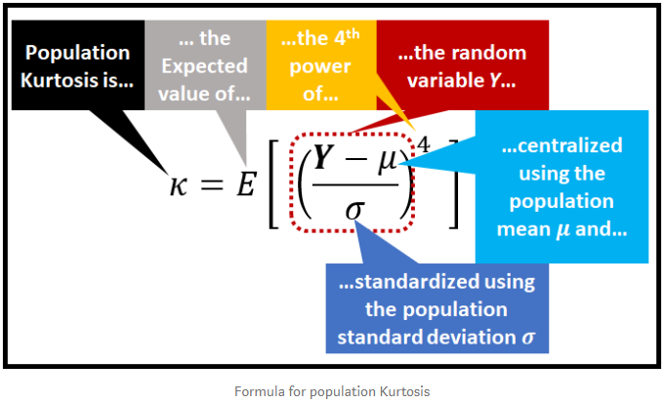
Kurtosis is the fourth standardized central moment, of the random variable of the probability distribution

Slide 9
Kurtosis
Standardised (i.e. mean = 0, std = 1)
Always positive
VERY sensitive to errors on tails (4th power)
Kurtosis of the Normal Distribution is 3.0
“Excess Kurtosis” is Kurtosis – 3.0

Slide 10
Testing results
Use
Omnibus K-squared
Jarque-Bera
to test is findings are statistically significant.
H₀ = The distribution is normally distributed
H₁ = The distribution is NOT normally distributed
What is the impact if the distribution is not normal?

Slide 11
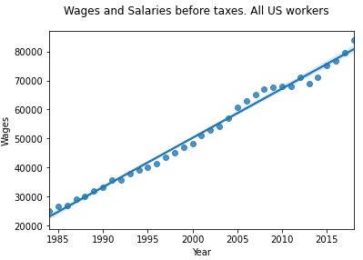
Example

Slide 12
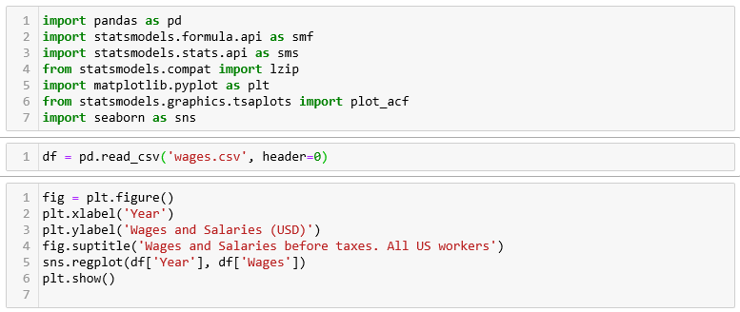

Slide 13
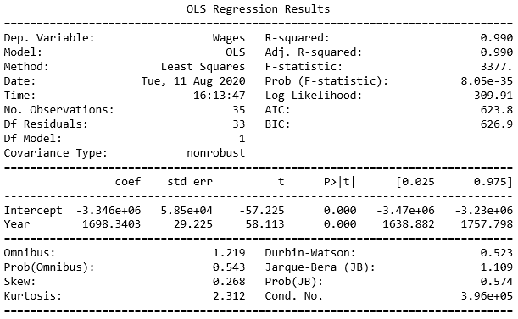

Slide 14
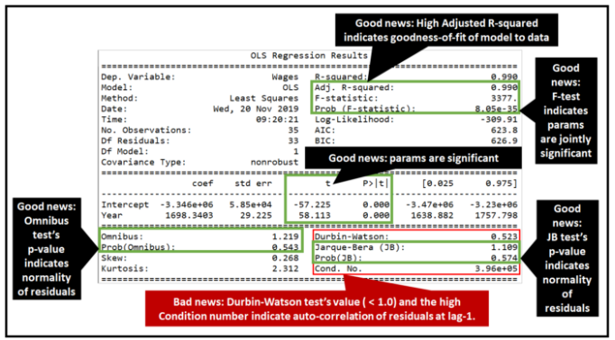

Slide 16
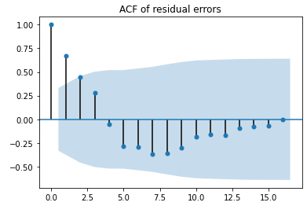

Slide 17
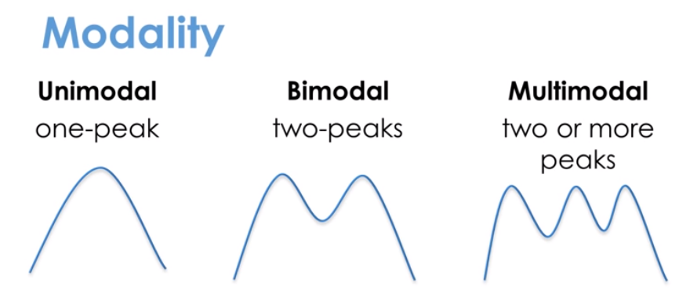
Watch out for

Slide 18
Linear & Non-linear Regression

Slide 19
Linear & Non-linear Variables
Linear
Non-linear (example)
y_{i} = β₀ + β₁x_{i} + ε_{i}
y_{i} = β₀ + β₁x_{i} + β₂ x_{i}² + ε_{i}

Slide 20
Linear & Non-linear Variables
More examples
y_{i} = β₀ + β₁x_{i}^{β3} + ε_{i}
y_{i} = β₀ + β₁sin(x_{i})+ β₂ x_{i}² + ε_{i}

Slide 21
One strategy
Include additional terms as columns

Slide 22
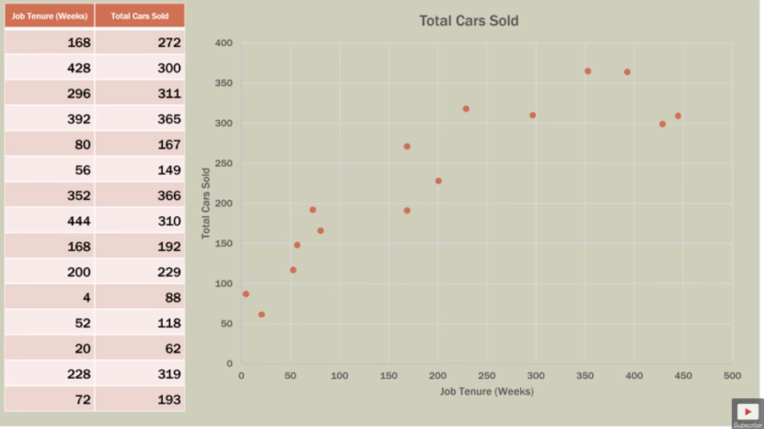

Slide 23
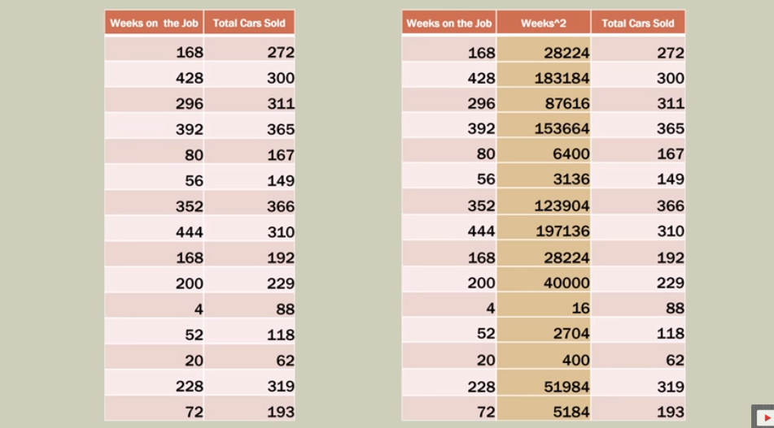

Slide 24
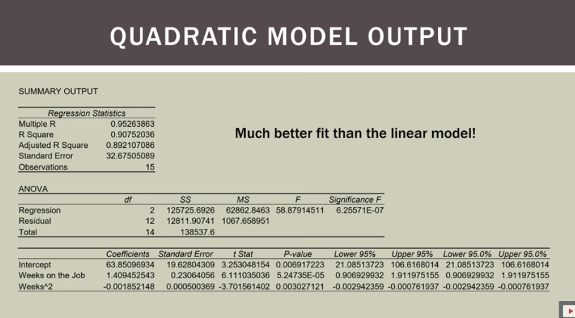

Slide 25
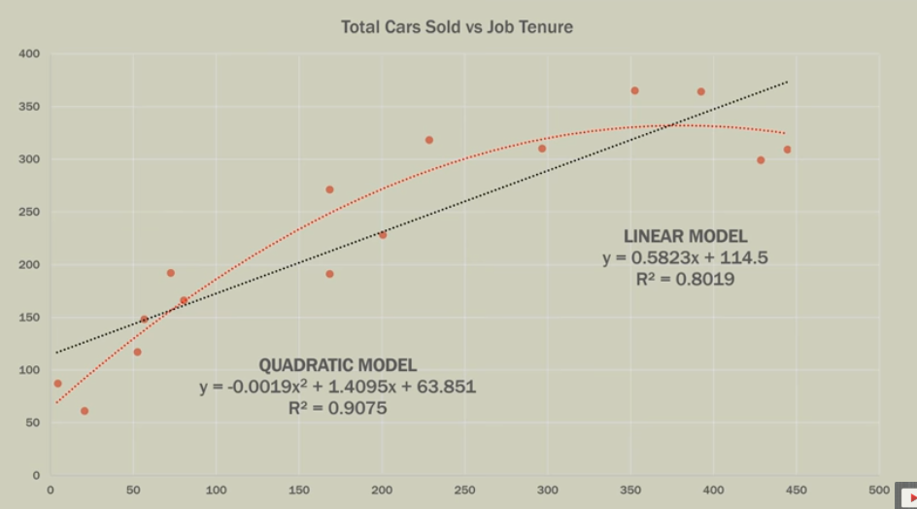

Slide 26
Dummy Variables

Slide 27
Strategy
Replace categorical with numeric
False, Male, Red = 0
True, Female, Green = 1

Slide 28
Sources
https://www.youtube.com/watch?v=HnMGKsupF8Q
https://towardsdatascience.com/understanding-the-ols-method-for-simple-linear-regression-e0a4e8f692cc
https://towardsdatascience.com/testing-for-normality-using-skewness-and-kurtosis-afd61be860
https://www.youtube.com/watch?v=UDHcn_1XneI
https://www.youtube.com/watch?v=WjdpbO3s-sQ

